Slide 1
Lecture 8
State & Props
Props are used to pass data from a parent component to a child component, while state is used to manage data within a component.
Props are immutable and cannot be changed within a component, while state is mutable and can be updated using the setState function.
Props are passed down from the parent component and are read-only within the child component, while state is only accessible within the component where it is defined.
Props can be used to customize the behavior or appearance of a component, while state is used to keep track of information that can change over time.

Slide 2
Props in React JS
function ChildComponent(props) {
return <div>{props.message}</div>;
}
function ParentComponent() {
return <ChildComponent message="Hello, World!" />;
}
You can also use in app.js & passes props to components.

Slide 3
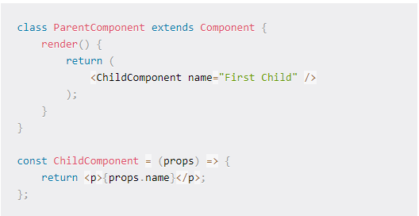
How to pass data with props

Slide 4
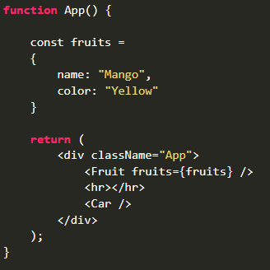
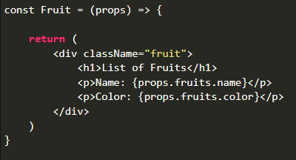
You can use object as props

Slide 5
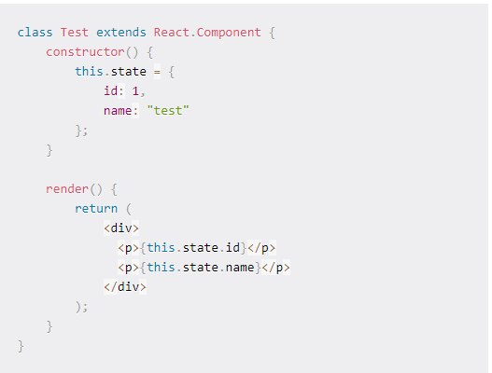
How can we use State

Slide 6
Example - State In React Js
import React, { useState } from 'react';
function Counter() {
const [count, setCount] = useState(0);
function handleClick() {
setCount(count + 1); }
return (
<div>
<p>Count: {count}</p>
<button onClick={handleClick}>Increment</button>
</div>
);}

Slide 7
Class Components
A class component must include extends React.Component
It also requires render() method
Example :
class ABC extends React.Component {
render(){
return <h3>My Class Component</h3>
}
}

Slide 8
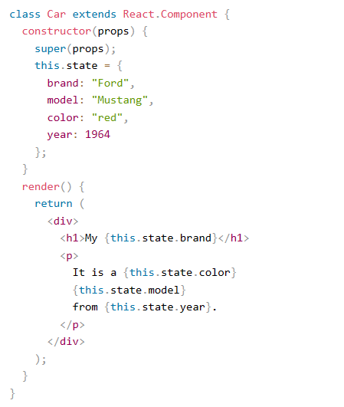
Using State Object

Slide 9
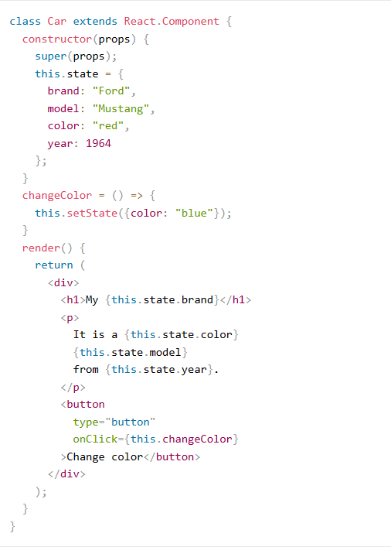
Changing State Object Value
You can use this.setState()

Slide 10
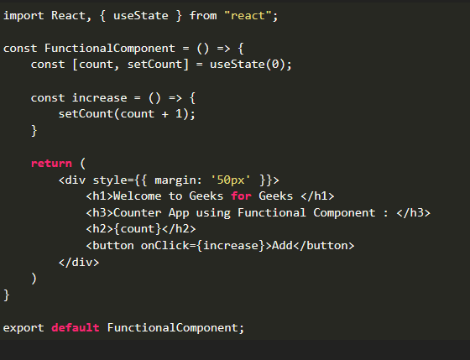
Functional Components
A stateless component, also known as a functional component

Slide 11
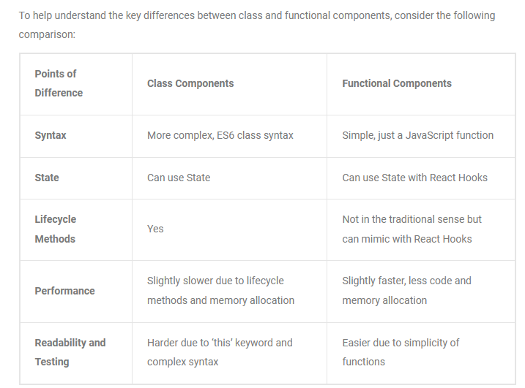
Difference B/w Function & Class Components

Slide 12
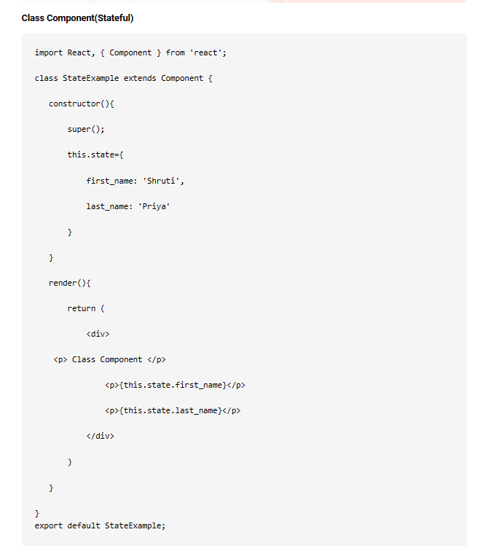
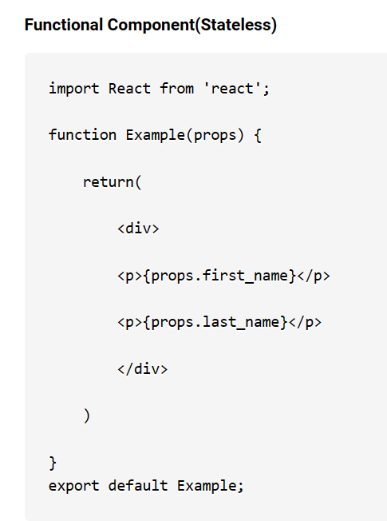

Slide 13
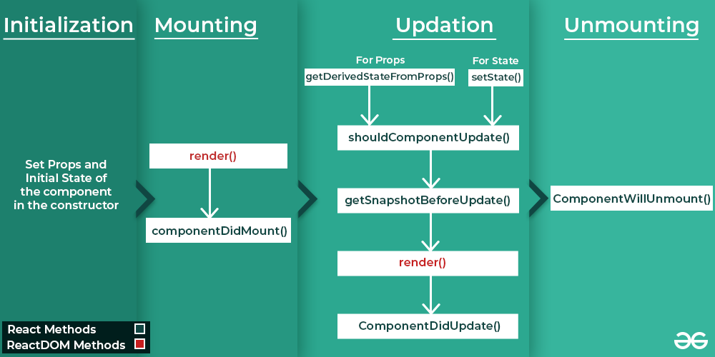
Component Life Cycle

